Slide 1

COMPUTER NETWORKS
Chapter 7. Wireless and Mobile Networks
Presented By:
KOKAB NAVEED
2021-SE-03

Slide 2

Topics to be covered
Mobility in the same IP subnet
Advanced features in 802.11
Personal Area Networks

Slide 3
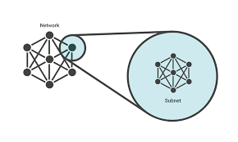
Mobility in the same IP subnet:
What is subnet?
In computer networking, a subnet, or subnetwork, is a logical subdivision of an IP network. It is a way of dividing a large network into smaller and more manageable networks.

Slide 4
Mobility in the same IP subnet?
Mobility in the same IP subnet refers to the ability of a device to move within a network while maintaining its IP address, typically within the same subnet.
This concept is often associated with scenarios where devices need to stay connected to the network even as they physically move around, such as in wireless networks or when using mobile devices.

Slide 5
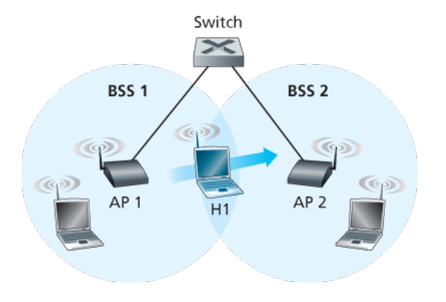
Mobility in the same IP subnet:
This figure shows :
BSS1
BSS2
Host (H1 moving from BSS1 to BSS2)
Switch

Slide 6
But what specifically happens when H1 moves from BSS1 to BSS2?
As H1 wanders away from AP1:
H1 detects a weakening signal from AP1
And it starts to scan for a stronger signal.
H1 receives beacon frames from AP2 (which in many corporate and university settings will have the same SSID as AP1).
H1 then disassociates with AP1 and associates with AP2, while keeping its IP address and maintaining its ongoing TCP sessions.

Slide 7
But how does switch know that the host has moved from one AP to another?
Switches are “self-learning” and automatically build their forwarding tables. This self-learning feature nicely handles occasional moves.
The AP2 sends a broadcast Ethernet frame with the Host’s source address to the switch.
The switch receives the frame and updates its forwarding table so that traffic destined to the Host is directed to the AP2.

Slide 8

Advanced Features of 802.11:
We’ll wrap up our coverage of 802.11 with a short discussion of two advanced capabilities found in 802.11 networks.
802.11 Rate Adaptation
Power Management

Slide 9
802.11 Rate Adaptation:
Some 802.11 implementations have a rate adaptation capability that adaptively selects the underlying physical-layer modulation technique to use based on current or recent channel characteristics.
Consider for example a mobile 802.11 user who is initially 20 meters away from the base station, with a high signal-to-noise ratio(SNR).
Given the high SNR, the user can communicate with the base station using a physical-layer modulation technique that provides high transmission rates while maintaining a low BER.
This is one happy user!

Slide 10
802.11 Rate Adaptation:
Suppose now that the user becomes mobile, walking away from the base station, with the SNR falling as the distance from the base station increases.
In this case, if the modulation technique used in the 802.11 protocol operating between the base station and the user does not change, the BER will become unacceptably high as the SNR decreases, and eventually no transmitted frames will be received correctly.
For this reason, some 802.11 implementations have a rate adaptation capability.

Slide 11
802.11 Rate Adaptation:
If a node sends two frames in a row without receiving an acknowledgment the transmission rate falls back to the next lower rate.
If 10 frames in a row are acknowledged, or if a timer that tracks the time since the last fallback expires, the transmission rate increases to the next higher rate.
This rate adaptation mechanism shares the same “probing” philosophy as TCP’s congestion-control mechanism.

Slide 12
Power Management:
. Power is a precious resource in mobile devices, and thus the 802.11
standard provides power management capabilities that allow 802.11
nodes to minimize the amount of time that their sense, transmit,
and receive functions and other circuitry need to be “on.”
. It's a way for devices to take short naps and wake up quickly to
check if anything important happened, allowing them to save energy
and extend battery life.

Slide 13
Power Management:
802.11 power management operate as follows:
Sleep and Wake States
Scheduled Wake-Up
Access Point Awareness
Quick Wake-Up
Checking for Messages
Decision to Go Back to Sleep or Stay Awake
Energy Savings

Slide 14

Personal Area Networks:
Two wireless protocols in the IEEE 802 family are:
Bluetooth
Zigbee

Slide 15
Bluetooth:
An IEEE 802.15.1 network operates over a short range, at low power, and at low cost.
Operates in the 2.4 GHz frequency without needing a license.
Uses a technique called Time Division Multiplexing (TDM), where devices take turns to transmit in short time slots of 625 microseconds.
There are 79 channels available for communication, and devices switch between them in a pattern to avoid interference.
To prevent interference, devices use a method called Frequency-Hopping Spread Spectrum (FHSS).
This means they jump between different channels during each time slot, making communication more reliable.

Slide 16
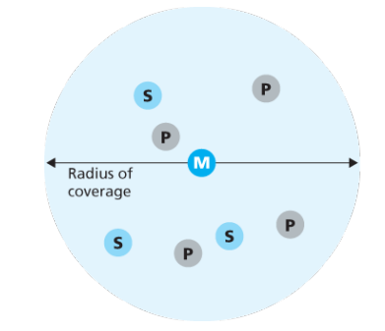
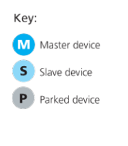
Bluetooth:
Can provide data rates up to 4 Megabits per second (Mbps).
No need for a central device like an access point.
Devices organize themselves into small groups called piconets.
A piconet consists of up to eight devices, with one device acting as the "master" and others as "slaves."
The master sets the timing, decides when devices can talk, and controls the overall communication in the piconet.

Slide 17
Bluetooth:
Besides active devices, there can be up to 255 "parked" devices.
Parked devices are in a low-power state and can't communicate until the master changes their status to "active."

Slide 18
Zigbee:
Zigbee is a type of personal area network standardized by IEEE under the 802.15.4 standard.
It's designed for low-power, low-data-rate applications, making it suitable for simple and cost-effective devices like home sensors, security devices, and switches.
Zigbee defines channel rates ranging from 20 to 250 Kbps, depending on the channel frequency.

Slide 19
Zigbee:
Zigbee networks consist of two types of nodes:
Reduced-Function Devices (RFDs): These are like Bluetooth slave devices.
Full-Function Devices (FFDs): These can act as master devices, controlling multiple slave devices. They can also form mesh networks.

Slide 20
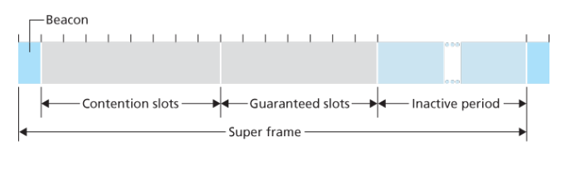
Zigbee:
Time is divided into recurring super frames in Zigbee networks.
Each super frame begins with a beacon frame, dividing the super frame into an active period (for transmission) and an inactive period (for power conservation).
The active period is further divided into 16 time slots:
  Some slots use CSMA/CA random access.
  Others are allocated by the controller to specific devices, ensuring guaranteed channel access for those devices.
Zigbee allows devices, including the controller, to sleep during the inactive period to conserve power.

